Slide 1

Writing Instructional Objectives
(an introduction) Presented by Steven Baratz
Notes:
Hi – welcome, thanks for having me here!
Today we’re going to have a mini-lesson – an introduction to Writing Instructional Objectives.
Instructional Design 101?
Even if you’re familiar with these concepts, it’s a good idea to revisit them from time to time...

Slide 2

Goals for today
Review instructional design principles and processes (ADDIE, SAM, Backward Design)
Identify “fuzzy” learning objectives
Three characteristics of solid learning objectives: Performance, Conditions, Criteria
Notes:
We’ll start with a framework to make sure we’re on the same page.
Goals for today’s session:
Review instructional design principles and processes.
2) Recognize “fuzzy” learning objectives.
3) Go over Three characteristics of solid learning objectives: Performance, Conditions, and Criteria.

Slide 3
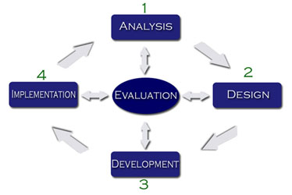
Instructional Design Process: ADDIE
Notes:
ADDIE – A common framework for Instructional DesigN.
Process similar to stages followed in application development lifecycle.
Not always strictly linear – I like this diagram – Evaluation is in the middle!
We are constantly evaluating at each stage!
ADDIE is not the only process out there. If you treat it as a flexible framework, it can still serve you well!

Slide 4

Instructional Design Process
SAM
“Successive Approximation Model”
Notes:
Alternative: Iterative design or SAM (successive approximation model) – small cycles of design/develop/implement/evaluate.
Get feedback early and often – refine your product as you go - saves time in the long run!

Slide 5

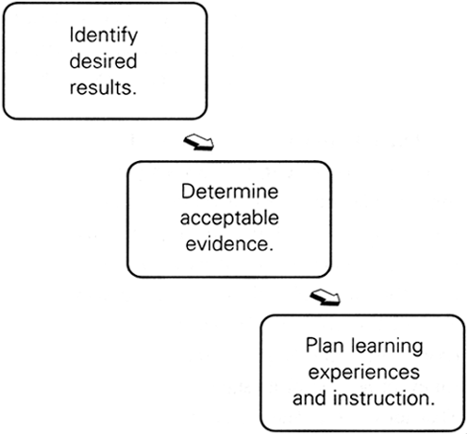
Backward Design
Notes:
We always talk about “The GAP” – Identifying the gap between what learners know now and what they need to know.
I spent a junior year abroad in London and whenever I hear about The GAP, I think of the London tube. Signs are everywhere to watch your step, or “MIND THE GAP!” when getting on or off the trains.
BACKWARD DESIGN means - begin with the end in mind.
Envison your desired state of affairs for end learners.

Slide 6
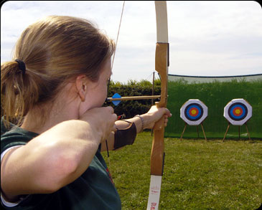
Where does backward design fit into ADDIE?
If you don’t have a target, how will you know if learners have hit the mark?
Notes:
ONLY when you know where you are going, can you then formulate learning objectives, assessment tools, and develop content and activities to help learners reach the objectives you’ve set.

Slide 7


Writing learning objectives
“Learners will know...”
But how?
Avoid Fuzzies!
Notes:
How will we know that they know?
Avoid “learners will know” or “learners will understand” because you can’t see or measure this.
How will you know that they know? How will THEY know that they know?

Slide 8
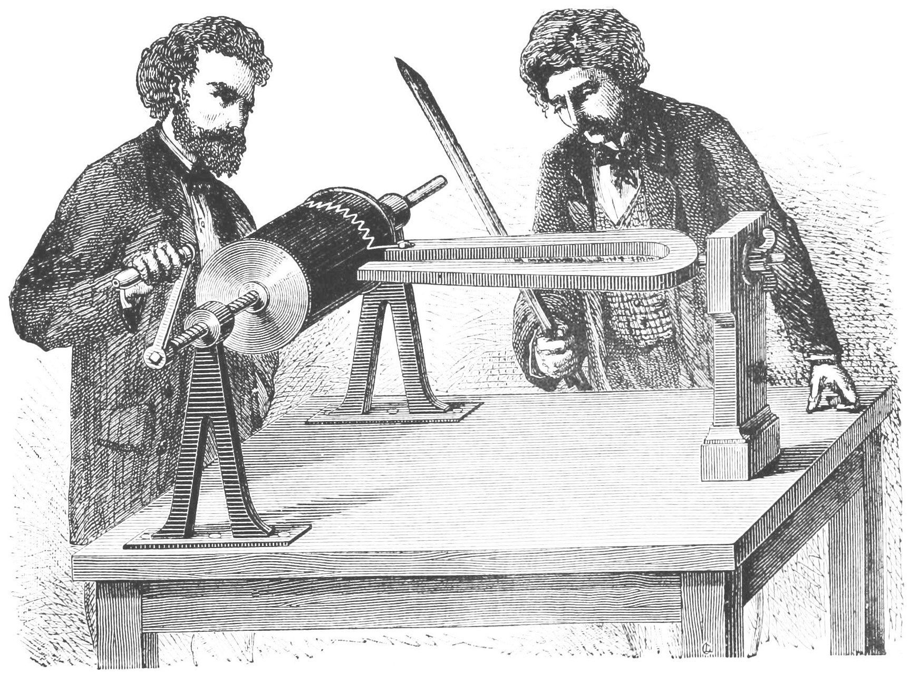
Improving learning objectives
Objectives must be measurable!
Is there a performance that can be observed?
Notes:
They must be able to demonstrate knowledge transfer! What’s a tangible result that’s observable and measurable?
A quiz question might work for some knowledge areas, however, if you are learning to ride a bike, a quiz question won’t demonstrate mastery – only riding a bike will!
(Dangerous occupations (like flying airplanes) have simulators, to practice safely!)

Slide 9

Define “objective”
An objective is a description of a performance you want learners to be able to exhibit before you consider them competent.
Notes:
An objective is a description of a performance you want learners to be able to exhibit before you consider them competent.

Slide 10
Fuzzy Objectives
1. Know how to operate a celphone.
2. Thread this needle.
3. Be able to describe the log-on procedure for your own computer.
4. Reassemble this pencil sharpener.
5. Demonstrate a deep understanding of the plays of Shakespeare.
6. Smile when addressing a customer.
7. Know thine enemy as thine self.
8. Identify four key updates in the latest software release by presenting a two-minute webinar to a customer.
Notes:
Time to practice. Turn to the first page of your handout.
Can you recognize fuzzy objectives?
Put a check mark beside statements that are fuzzy and require more clarification in order to measure them. Put a question mark beside any you’re not sure about.
Take a few minutes and look up when you’re done.

Slide 11
Consider including 3 characteristics:
1. Performance – observable/measurable behavior
Example: Be able to ride a bicycle.
2. Conditions – (if any)
Example: Be able to ride a bicycle on a flat surface.
3. Criteria – how well? To what standard? (Degree)
Example: Be able to ride a bicycle on a flat surface for 100 yards without falling.
Notes:
You don’t always need conditions or criteria, but learning objectives should be concrete and measurable.
Which one of these is the clearest and most easily measured?
Is a (measurable) performance stated? - An objective always states what a learner is expected to be able to do and/or produce to be considered competent.
The objective sometimes describes the product or result of the doing. Ask yourself, what is the learner doing when demonstrating achievement of the objective?
Are any conditions required to help equate to workplace performance? - An objective (may) include the important conditions under which the performance is to occur.
Are any specific criteria needed to measure or make results more meaningful? – An objective may include the criteria of acceptable performance: that is, it states how well someone would have to perform to be considered competent. You can also think of this as to what Degree? Wherever possible, an objective describes the criterion of acceptable performance by describing how well the learner must perform in order to be considered acceptable.

Slide 12
Now it’s your turn!
For extra credit:
In groups of 2 or 3 – You have 3 minutes!
Write one or more measurable learning objectives for a workplace training need you have identified...

Slide 13

Be creative - find what works for you!
Notes:
Would anyone like to share what they’ve written?
There are no hard and fast answers – every training situation has its own opportunities and challenges.
Find what works for you and most importantly, for your learners!
Analysis is key - audience, pre-existing knowledge or pre-requisites, technical considerations, and most importantly, a GAP analysis of what they know now and what they need to know – you’ll be well on your way to:

Slide 14

Notes:
SUCCESS!
Follow the guidelines you’ve practiced today for writing solid learning objectives and you’ll find it much easier to develop training materials that successfully reach your goals.

Slide 15
Thank you!
Questions or Comments?

